Slide 1


OMIS 661 – Business Intelligence Apps and Tools
Tool used:
Power BI
Dataset:
WideWorldImportersDW
By: Aditi Patel
This Photo by Unknown Author is licensed under CC BY

Slide 2

Presentation Overview
Wide World Importers Introduction
Objective / Research questions
Analysis and Visualizations
Recommendations
This Photo by Unknown author is licensed under CC BY-NC.

Slide 3

About Wide World Importers DW
Wide World Importers is an imaginary importer and distributor of novelty goods based in the San Francisco Bay Area and spread all over United States.
Company’s analysis and visualization is more focused on sales.
In this visualization, we will focus on both positive and negative impact of sales by analyzing profit and loss.
It includes modules like Sale and Movement.
This Photo by Unknown Author is licensed under CC BY-SA
Image source : Depositphotos.com

Slide 4
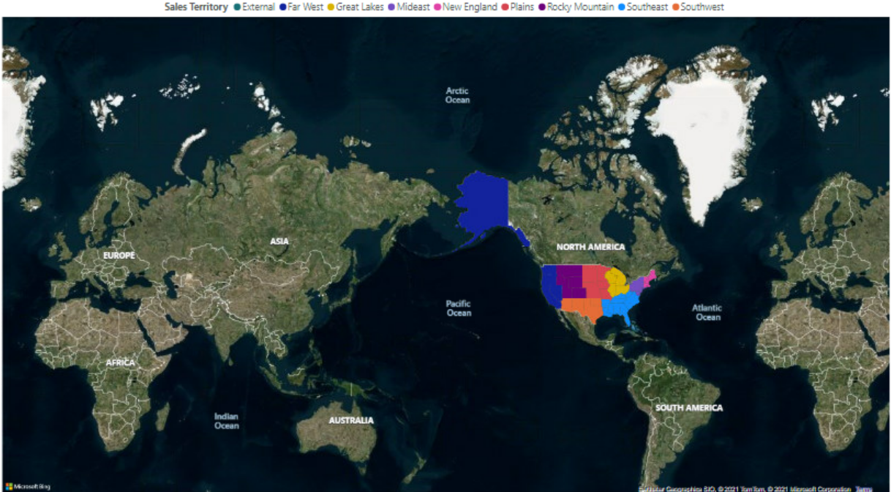
USA States

Slide 5
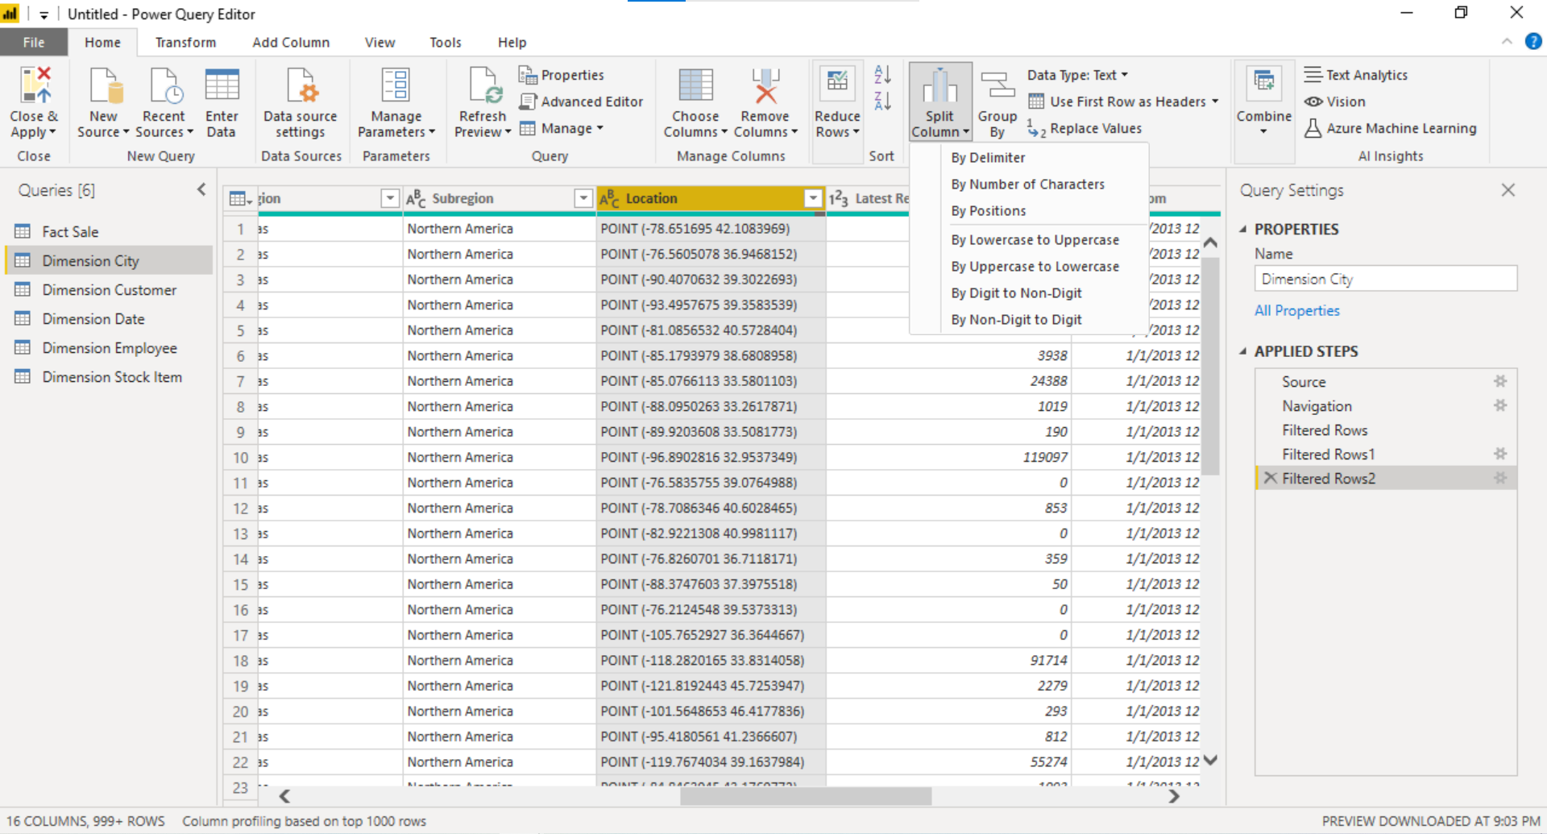
Data Preprocessing
Dataset contains some geographical data which needs to be flip(longitude and latitude).
Few columns needed to convert from number to labels.
Removing null values
Image source : Depositphotos.com

Slide 6
Research
As from the analysis there are few states which are in loss on certain products so Company needs to improve overall profit on those products and so that it can maintain profit throughout all the states in USA.
What can be factors affecting Profit ratio?

Slide 7
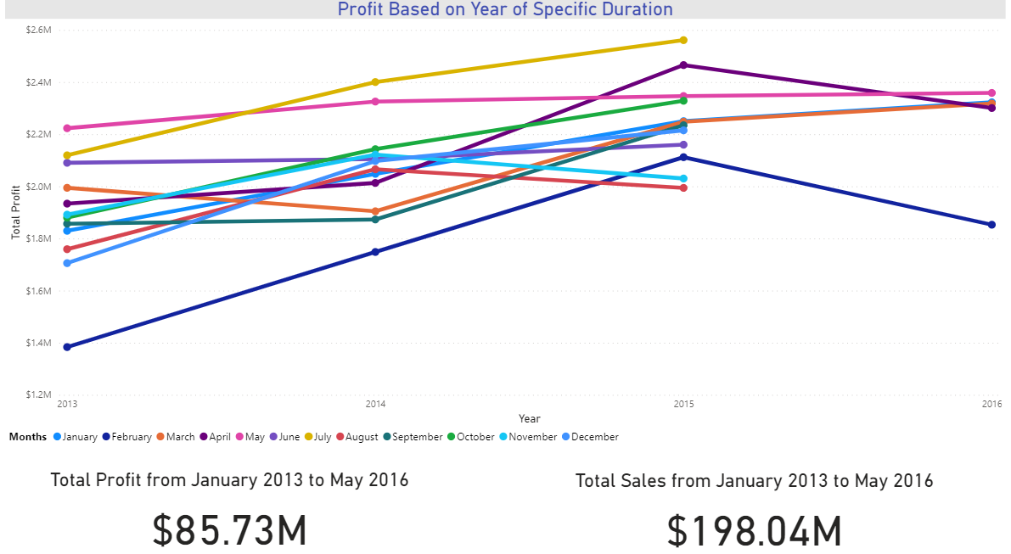
Duration of Data
Line Chart shows Profit based on Years.
January 2013 to May2016

Slide 8
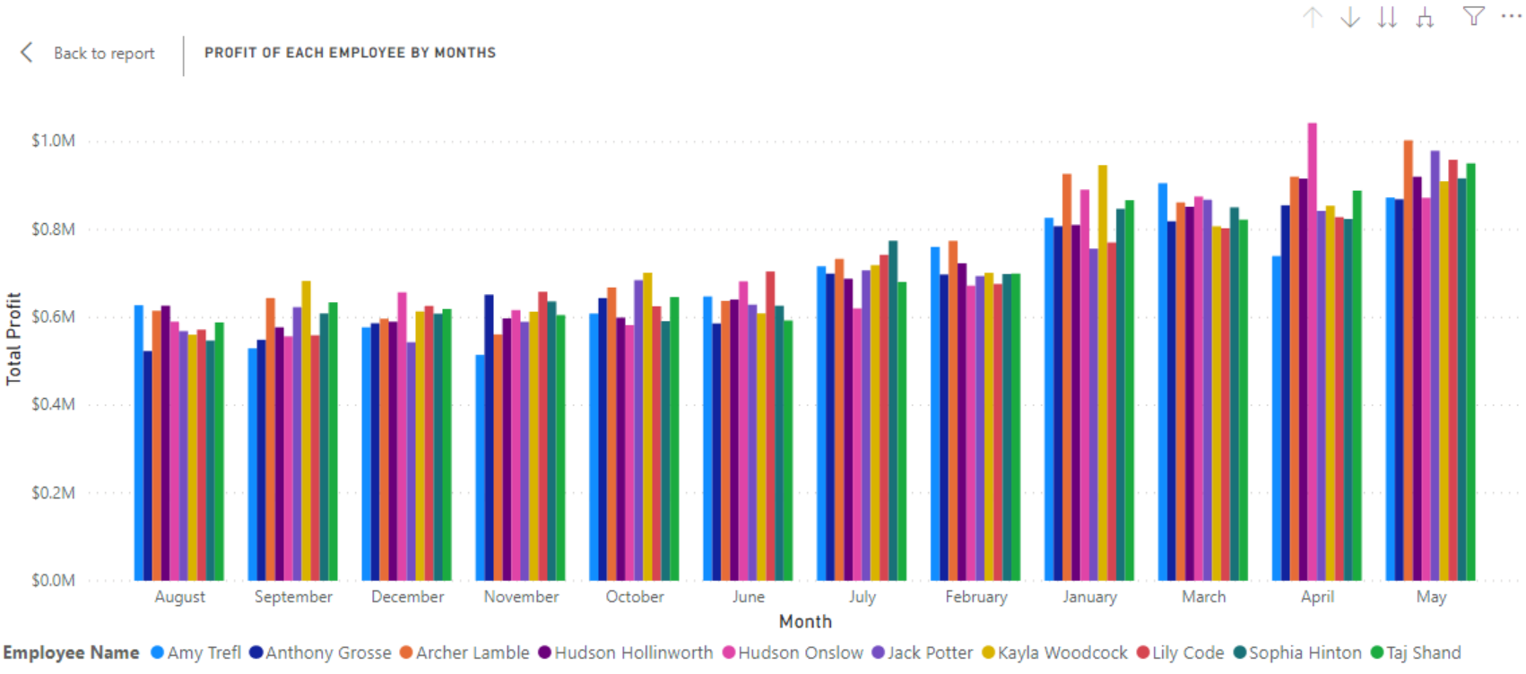
Analyzing Employee’s Productivity.
Clustered column chart shows low to high profit of each employee by months.
May seems the highest profitable month among all the months
August seems the lowest profitable month(could be because of duration).
Hudson Onslow makes highest profit among all.

Slide 9
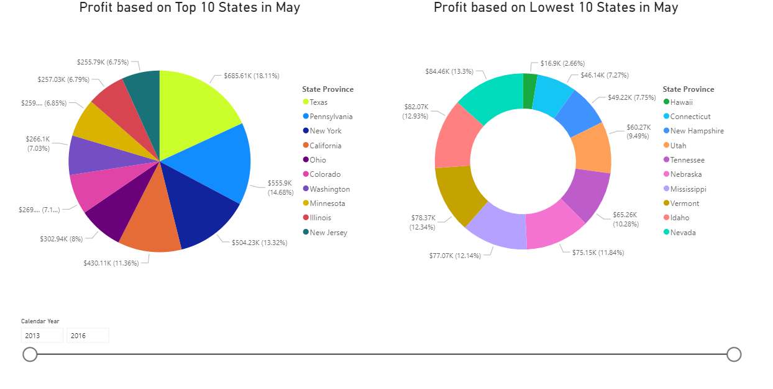
Findings in the Month of May(highest profitable month)
Going in dept, Pie chart and Donut chart shows Top and lowest Profitable States.
Texas seems most profitable state. It might possible that Hudson Onslow belongs to Texas or the population ratio in Texas is higher
Hawaii seems the lowest profitable state.

Slide 10
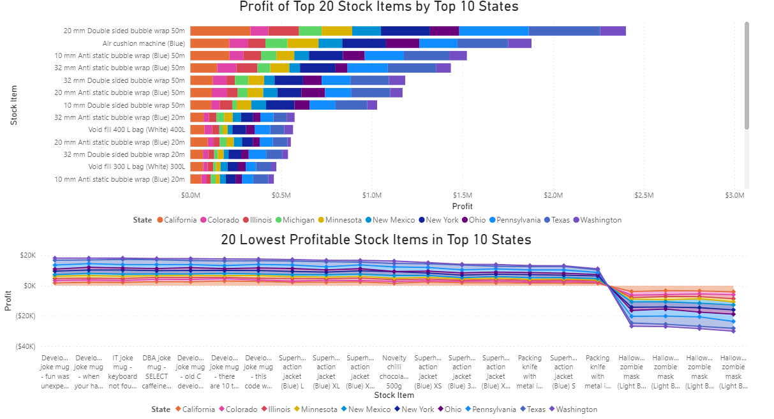
Findings on Top 10 States
It clearly shows that profit of certain stock items drops suddenly in stacked bar chart.(from static bubble wrap)
Few products(Halloween Zombie mask) which has negative profit which means company is losing money on those products.

Slide 11
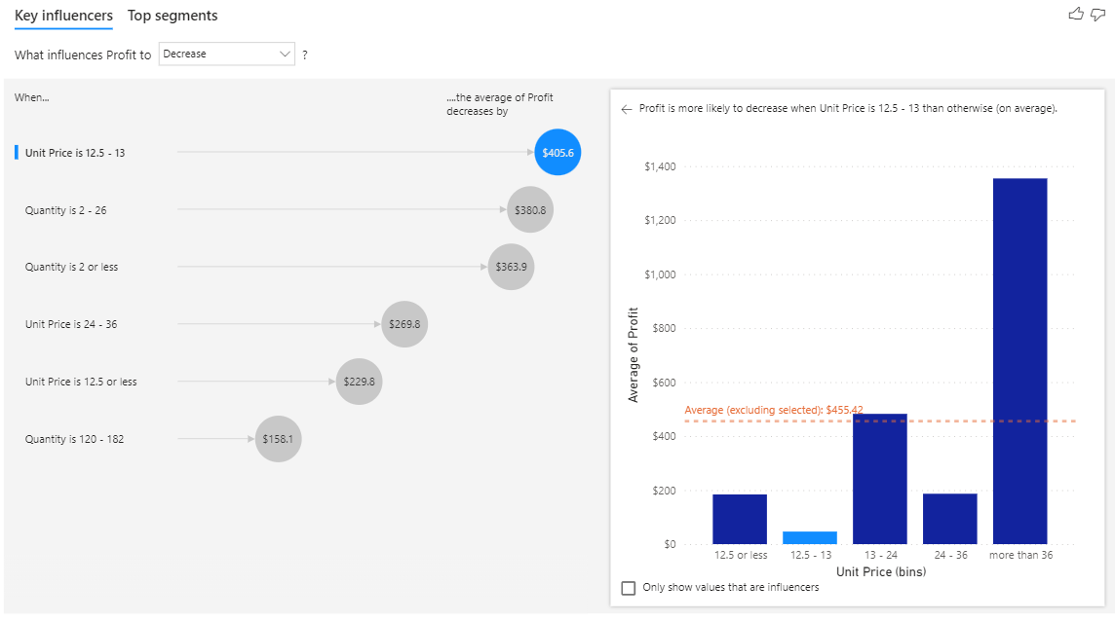
What can be Possibilities Of Profit to decrease
As in previous slide, profit drops from certain stock item.
Factoring Unit Price and Quantity.
Low unit price and low quantity
Low unit price, more quantity(rare case)

Slide 12
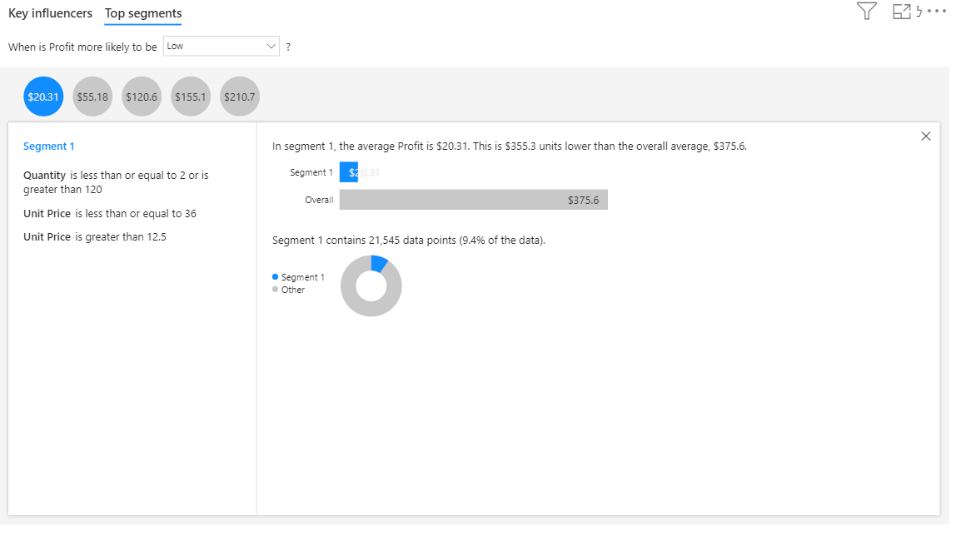
One of the Segment…
Five Segments
If quantity is >=120 but unit price is low
If Quantity is <=2 but unit price is high

Slide 13
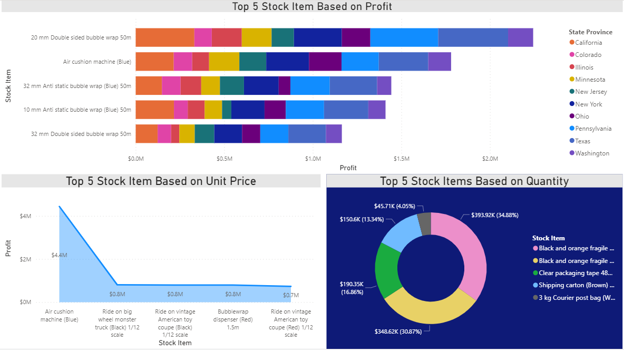
Factors affecting profit based on analysis…
Air Cushion machine is the second highest stock item based on Profit. And also, top stock item based on unit.
Conclude: Unit price has high profit and also highest price of single unit so it might possible that unit price affects profit.

Slide 14
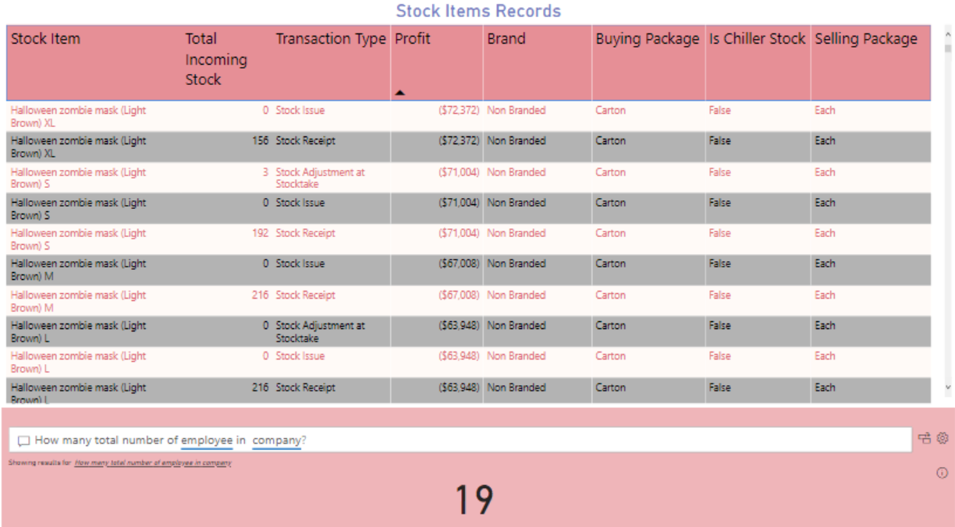
Another Possibilities…
Shows records of Stock Items which has detailed information of stocks movement like as we can see profit which is in () shows negative value and also has low incoming stock.
So, it might be a reason that items like Halloween Zombie masks in low stock items leads to a loss.

Slide 15
Recommendations
Should hire more people like Hudson Onslow and Archer Lambel or arrange some training sessions for other employees under the guidance of Productive employee.
Should focus more on increasing Unit price.
Concentrate on sales to the low populated states as from analysis all the top states seems highly populated, might take care of incoming goods to avoid shortage of items.
Above points might help to maintain profit ratio and it might help to increase profit to the products like Halloween zombie masks and also to the low populated states like Hawaii.

Slide 16

Dashboard link: https://app.powerbi.com/groups/me/dashboards/db2324e9-93d8-4751-861b-41421982e699
This Photo by Unknown Author is licensed under CC BY-NC

